Slide 1

The Colts Guide to
Google Classroom

Slide 2
What is
Google Classroom?
Think of Google Classroom (GC)
as your digital link to learning.
Teachers use GC to share assignments, homework, newsletters, and much more with students! Parents can also receive information too!

Slide 3
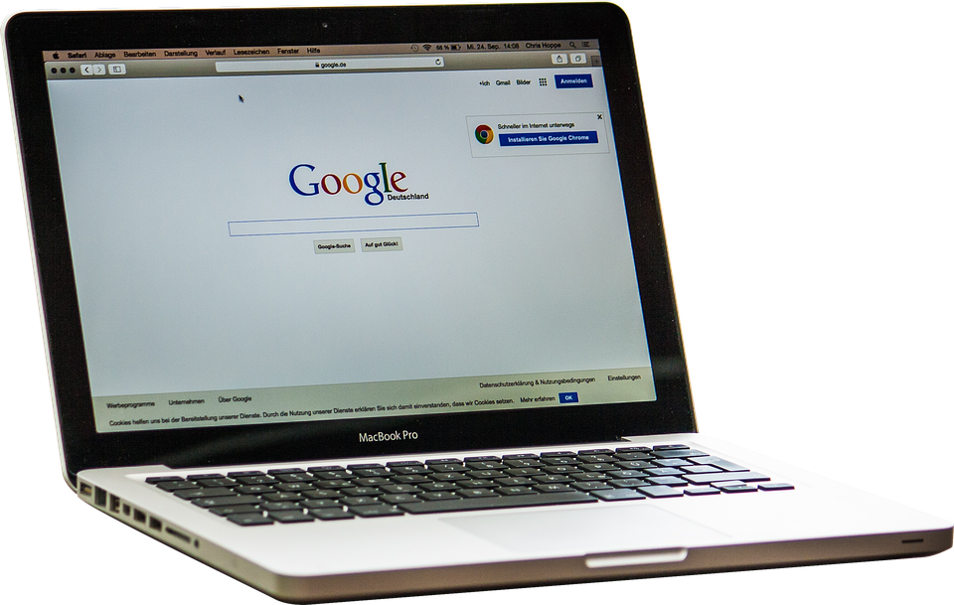
Getting Started
Students are provided with a secure login and password that is unique to them.
Check with the student’s district to obtain this private information. Guardians cannot obtain separate access, unless using their student’s login information.

Slide 4

Getting Started
1
Click on the Google Chrome browser icon.

Slide 5
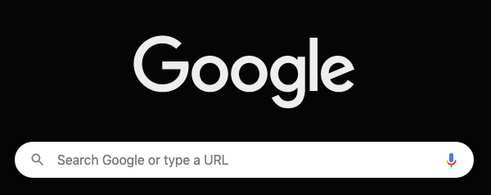
Getting Started
2
Type www.google.com into your web
address bar.
www.google.com

Slide 6
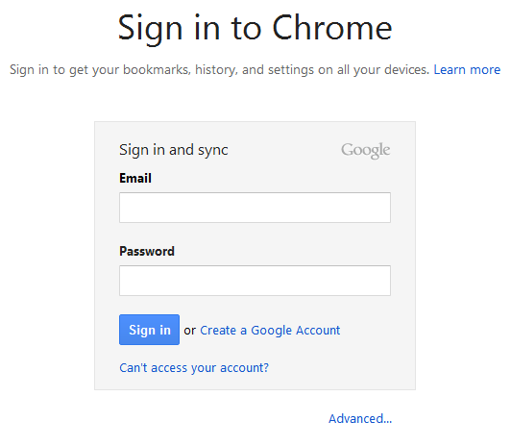
Getting Started
3
Click on SIGN IN in the upper right hand corner of the browser window.

Slide 7
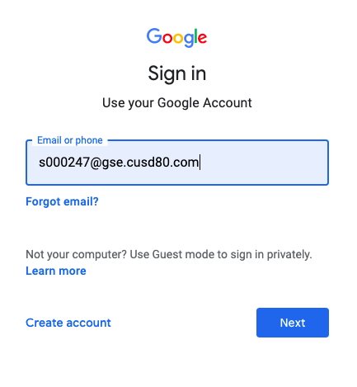
Getting Started
4
Type in your child’s GSE Email address & click “next.”

Slide 8
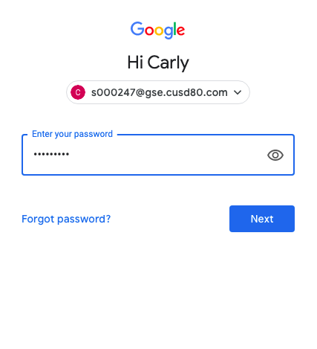
Getting Started
5
Type in your s + ID# + !
& click “next.”
**If you ever forget your password, email one of your teachers to reset it.

Slide 9
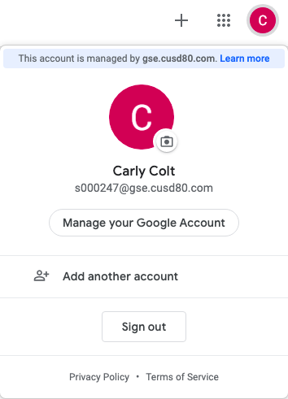
Now you’ll see
that you are signed in to your Google Apps for Education account!

Slide 10
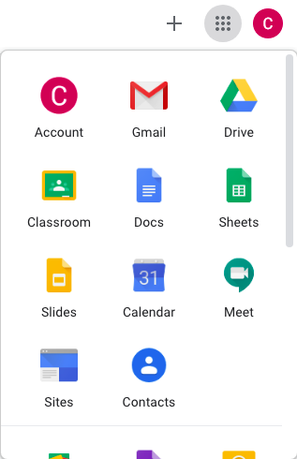
Google
suite
Click on the 9 squares
(Waffle/Apps Launcher) icon in the
top right hand corner to see
the Google Suite of Products!

Slide 11
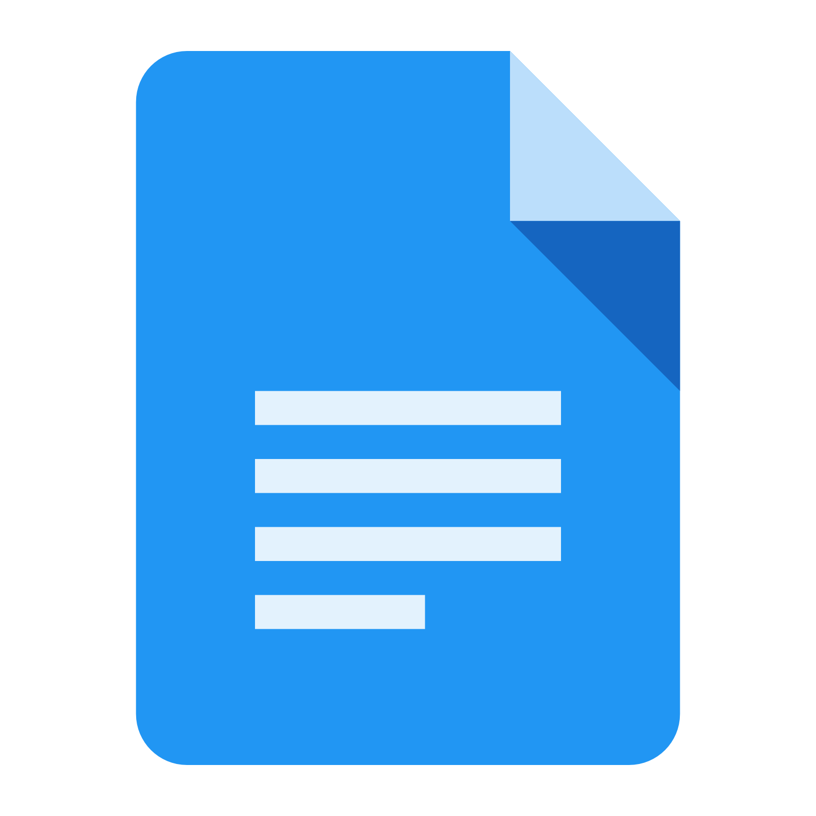


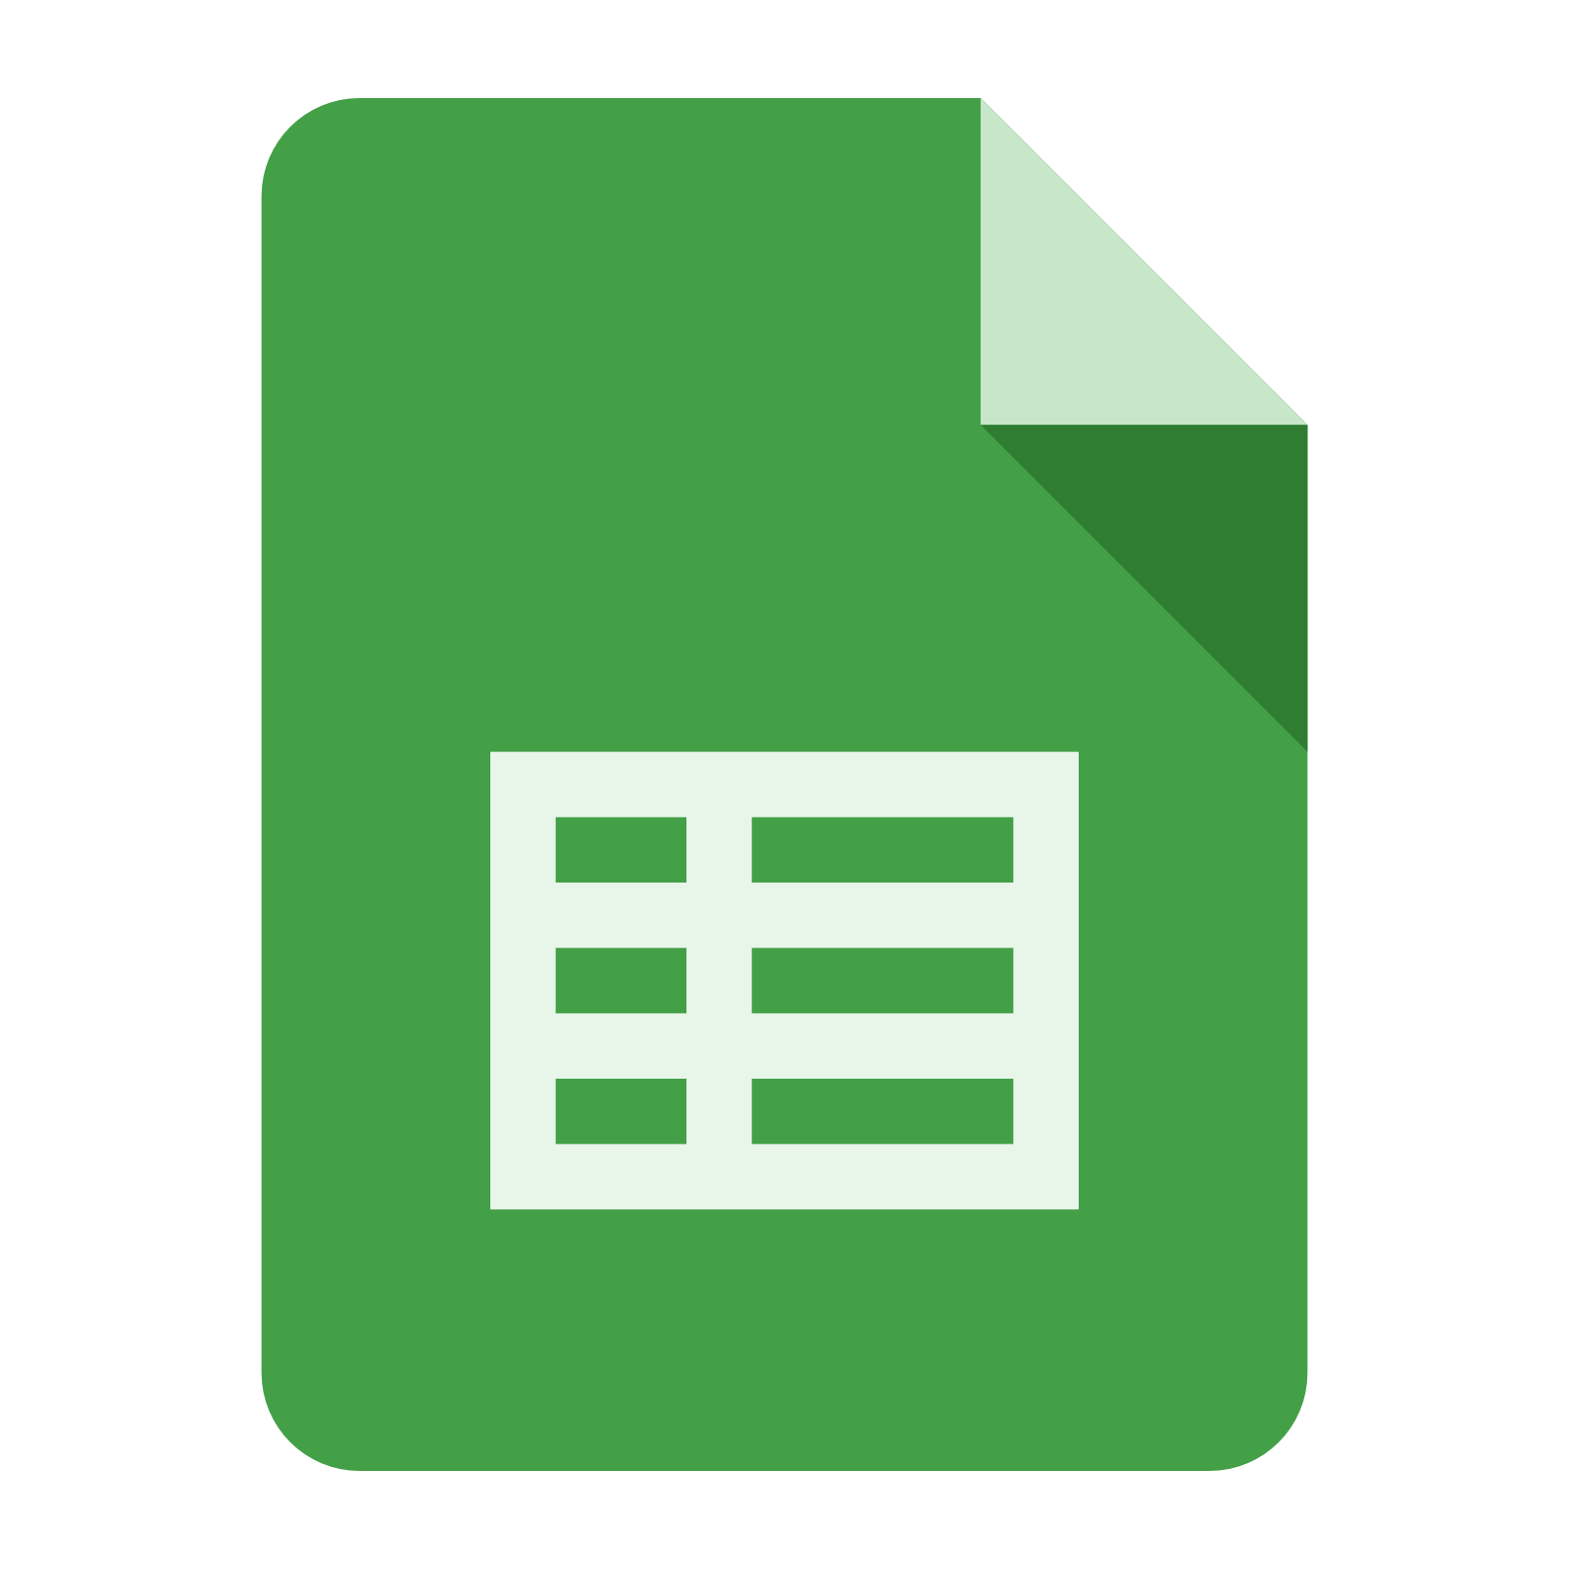
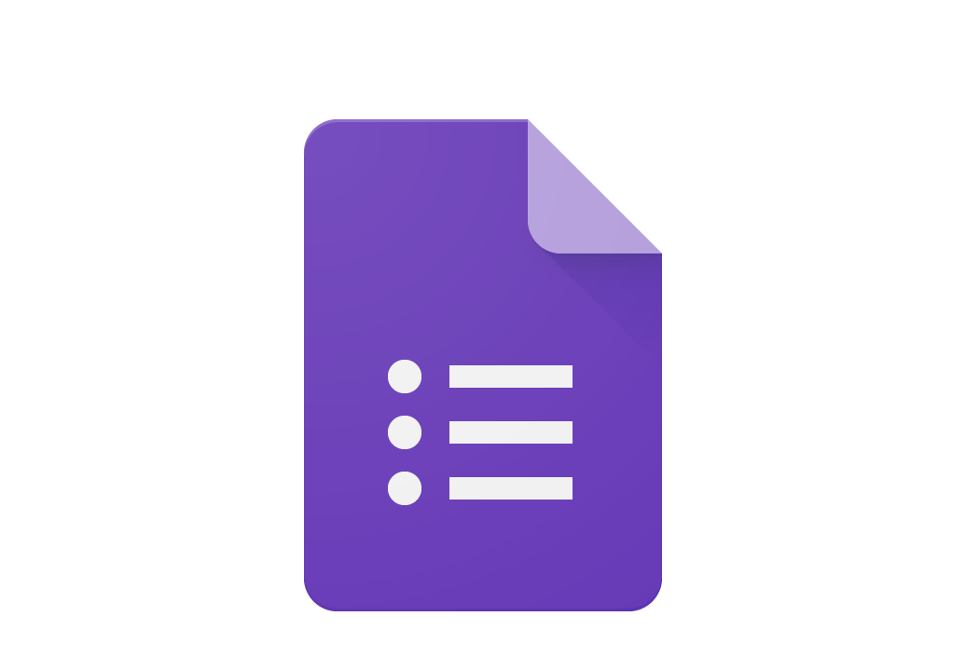
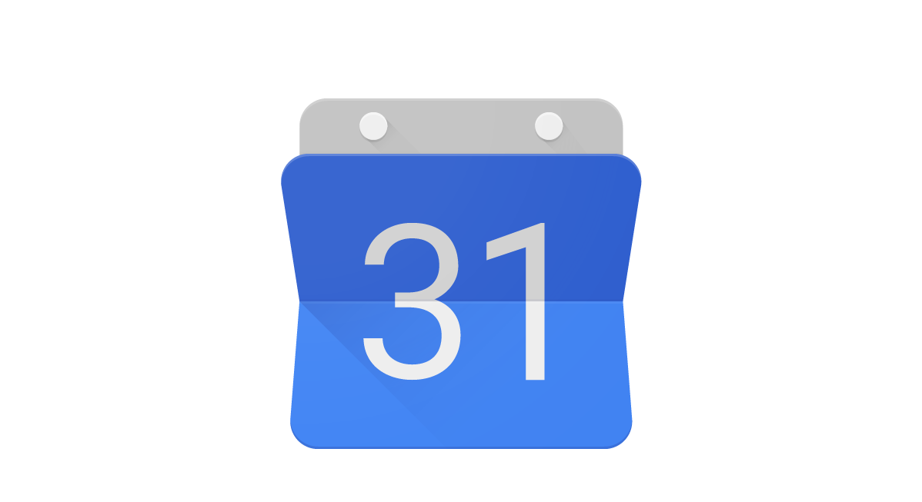

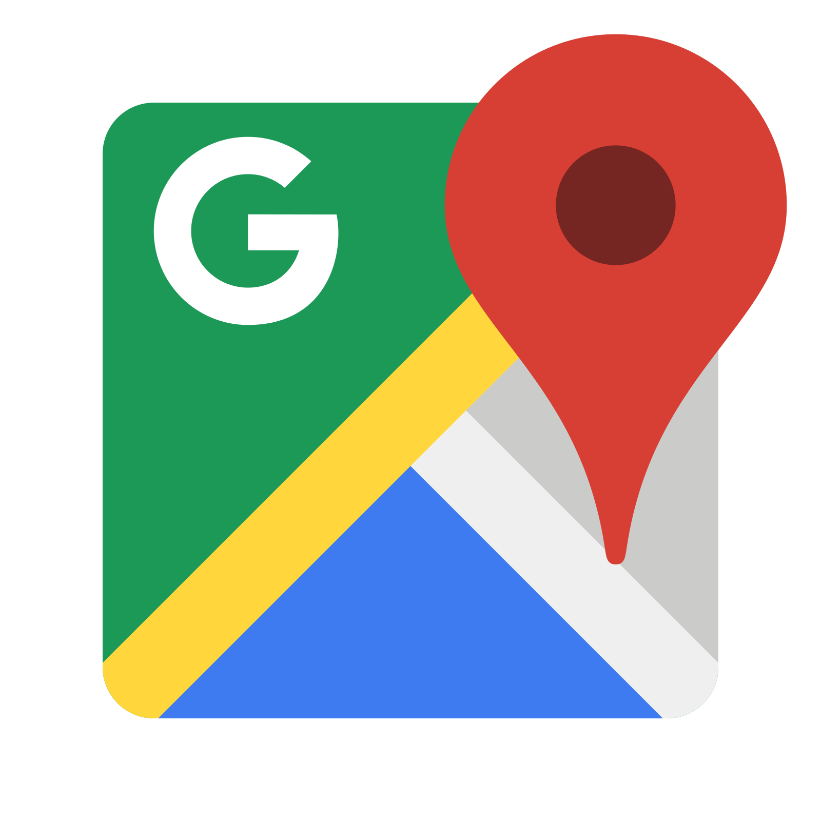

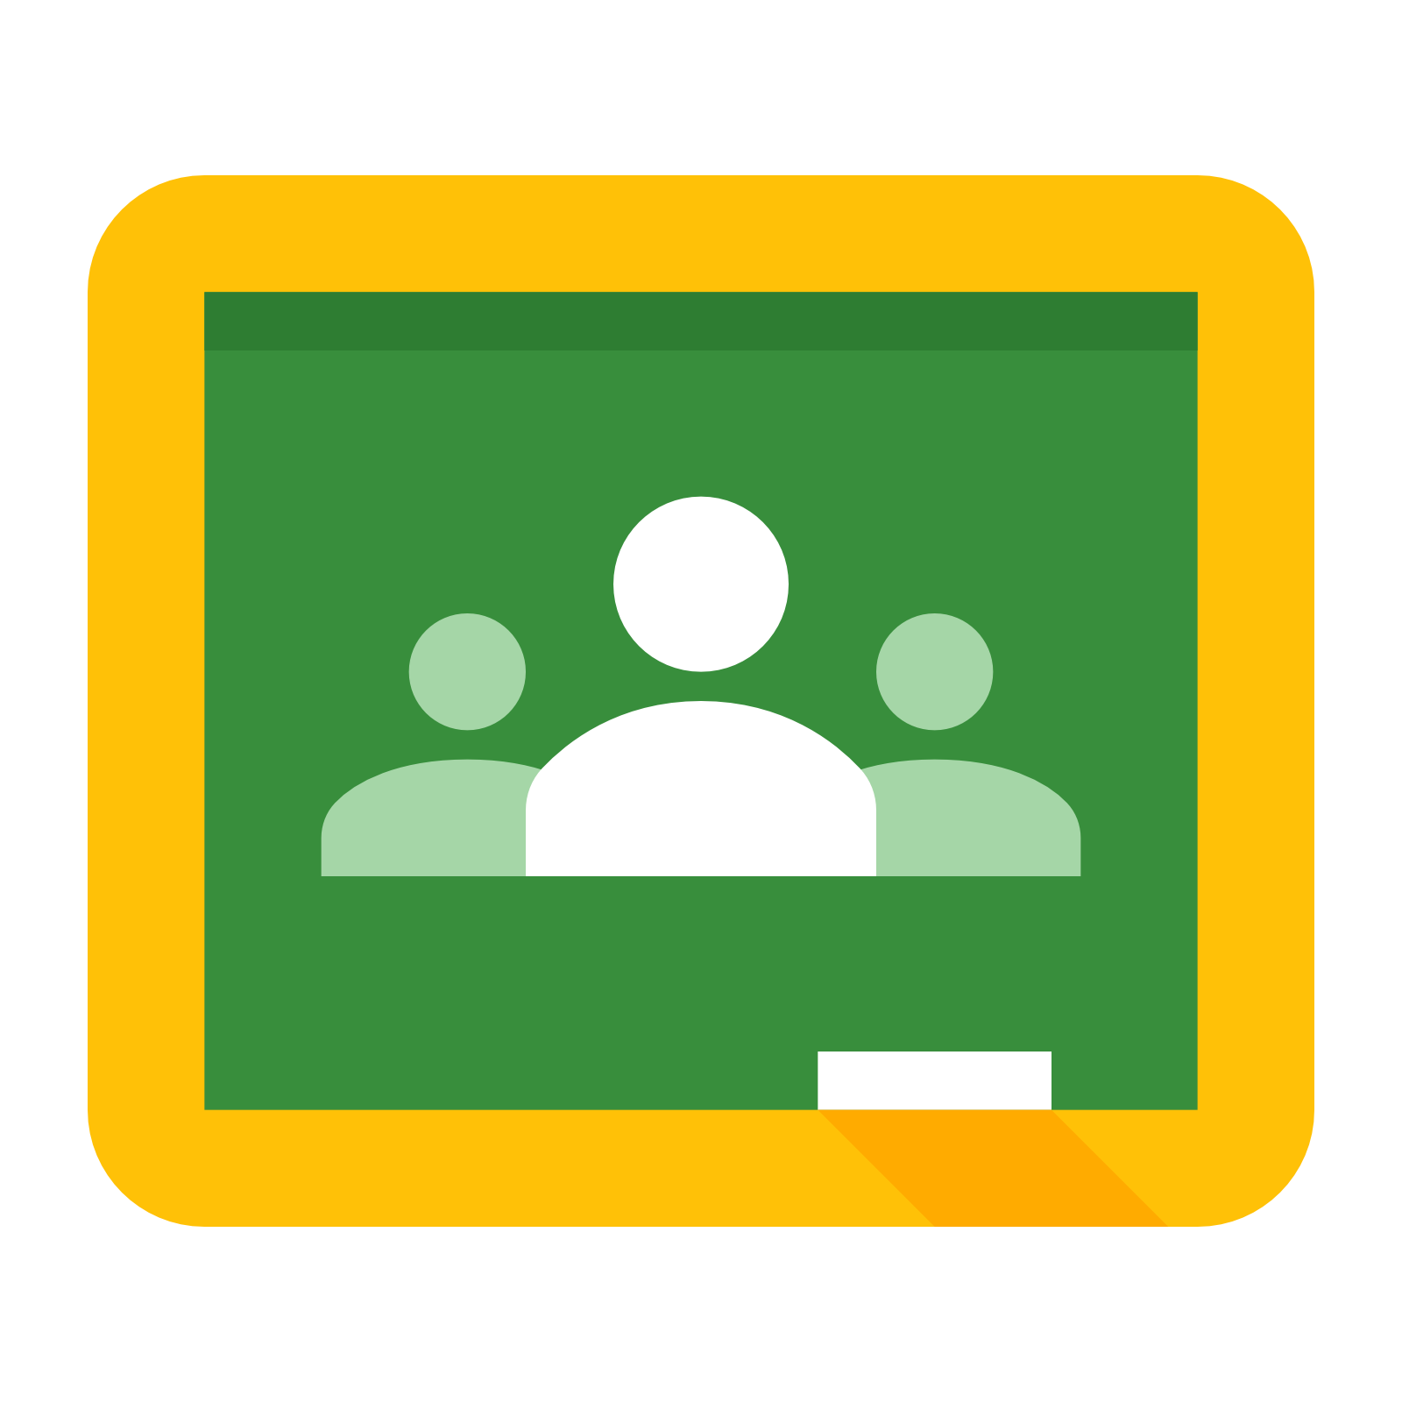







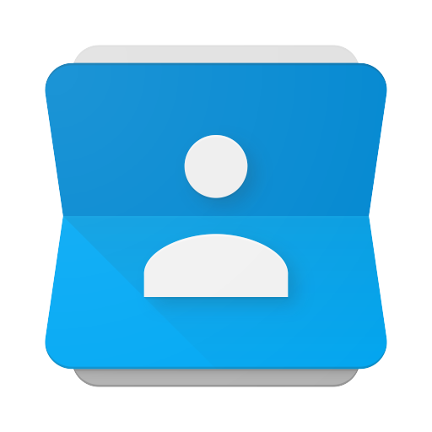


GOOGLE ICONS to recognize:
CHROME DOCS DRIVE SLIDES SHEETS FORMS CALENDAR
GMAIL PHOTOS MAPS KEEP CLASSROOM MEET GROUPS
SITES CONTACTS My Account CLOUD SEARCH YOUTUBE NEWS VAULT

Slide 12
Navigating Classroom
1
Click on the waffle button and then the
Google Classroom icon.

Slide 13
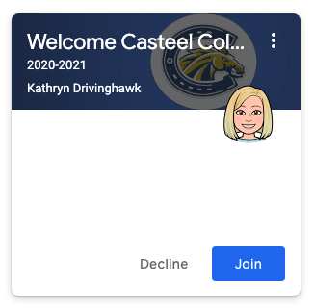
Navigating Classroom
2
Click on the class you wish to view and accept invitation.

Slide 14
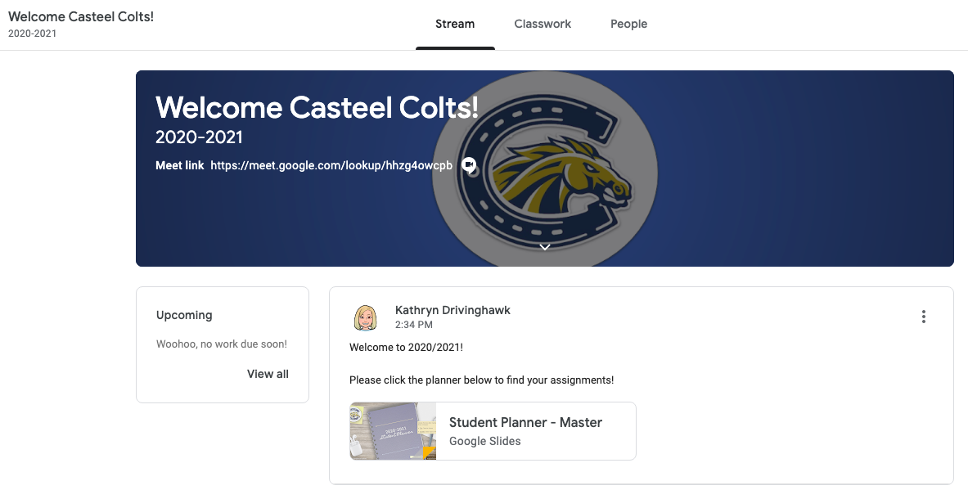
3
Read your teacher’s announcement(s).
Click their planner to find your assignments

Slide 15

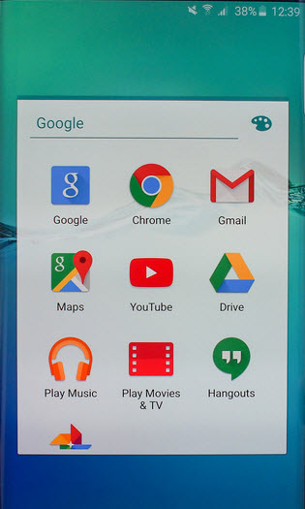
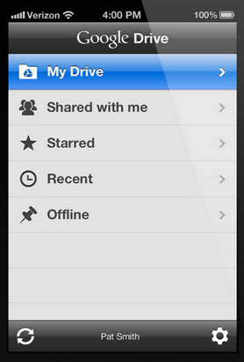
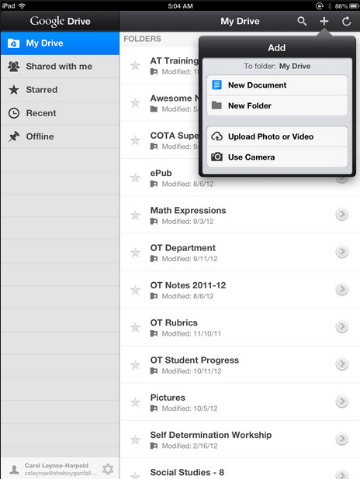
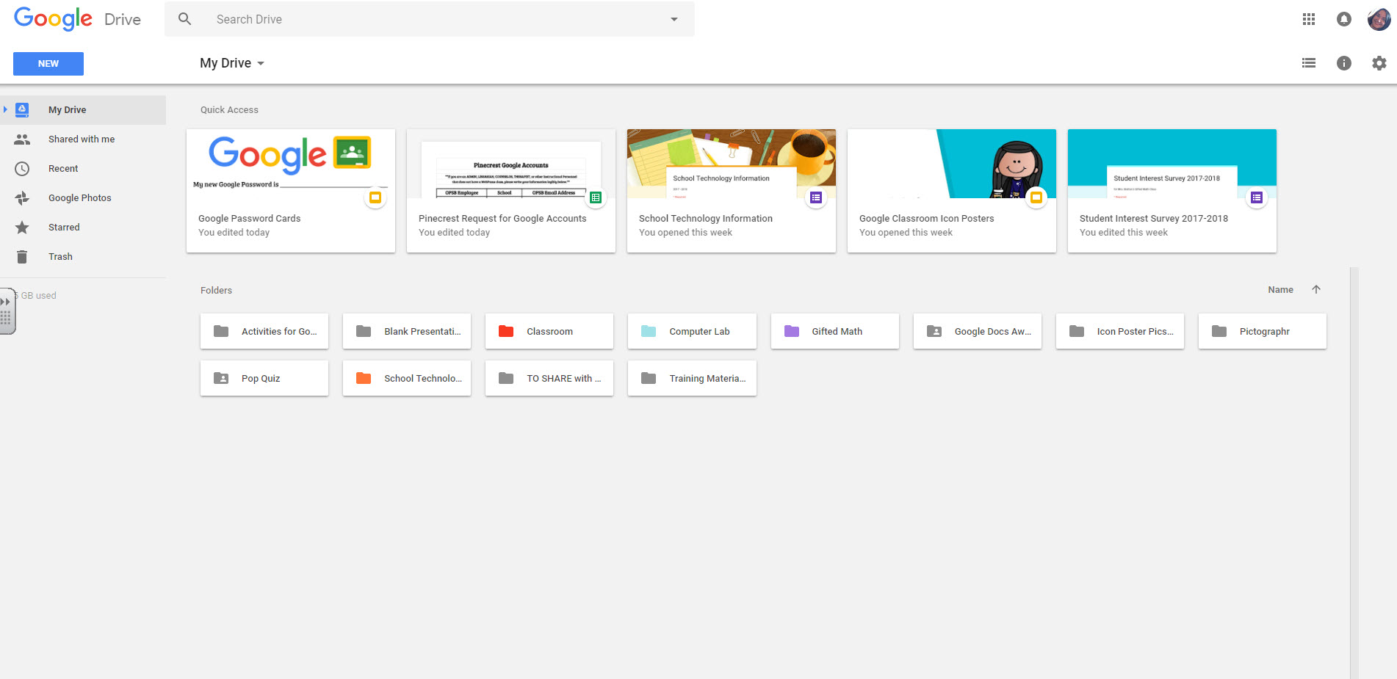
access
anywhere
Android
Iphone
Tablet
desktop

Slide 16


GOOGLE APPS
allow you to edit Google assignments from
any device that is connected to the internet and logged into your GSE account!

